Slide 1
A User-Guided Approach to Program Analysis
Ravi Mangal, Xin Zhang, Mayur Naik
Georgia Tech
Aditya Nori
Microsoft Research

Slide 2


Motivation
Program
Analysis
Program
Analysis
Approximations
Computing exact solutions impossible
Imprecisely defined properties
Analysis Writer
Missing program parts
…

Slide 3

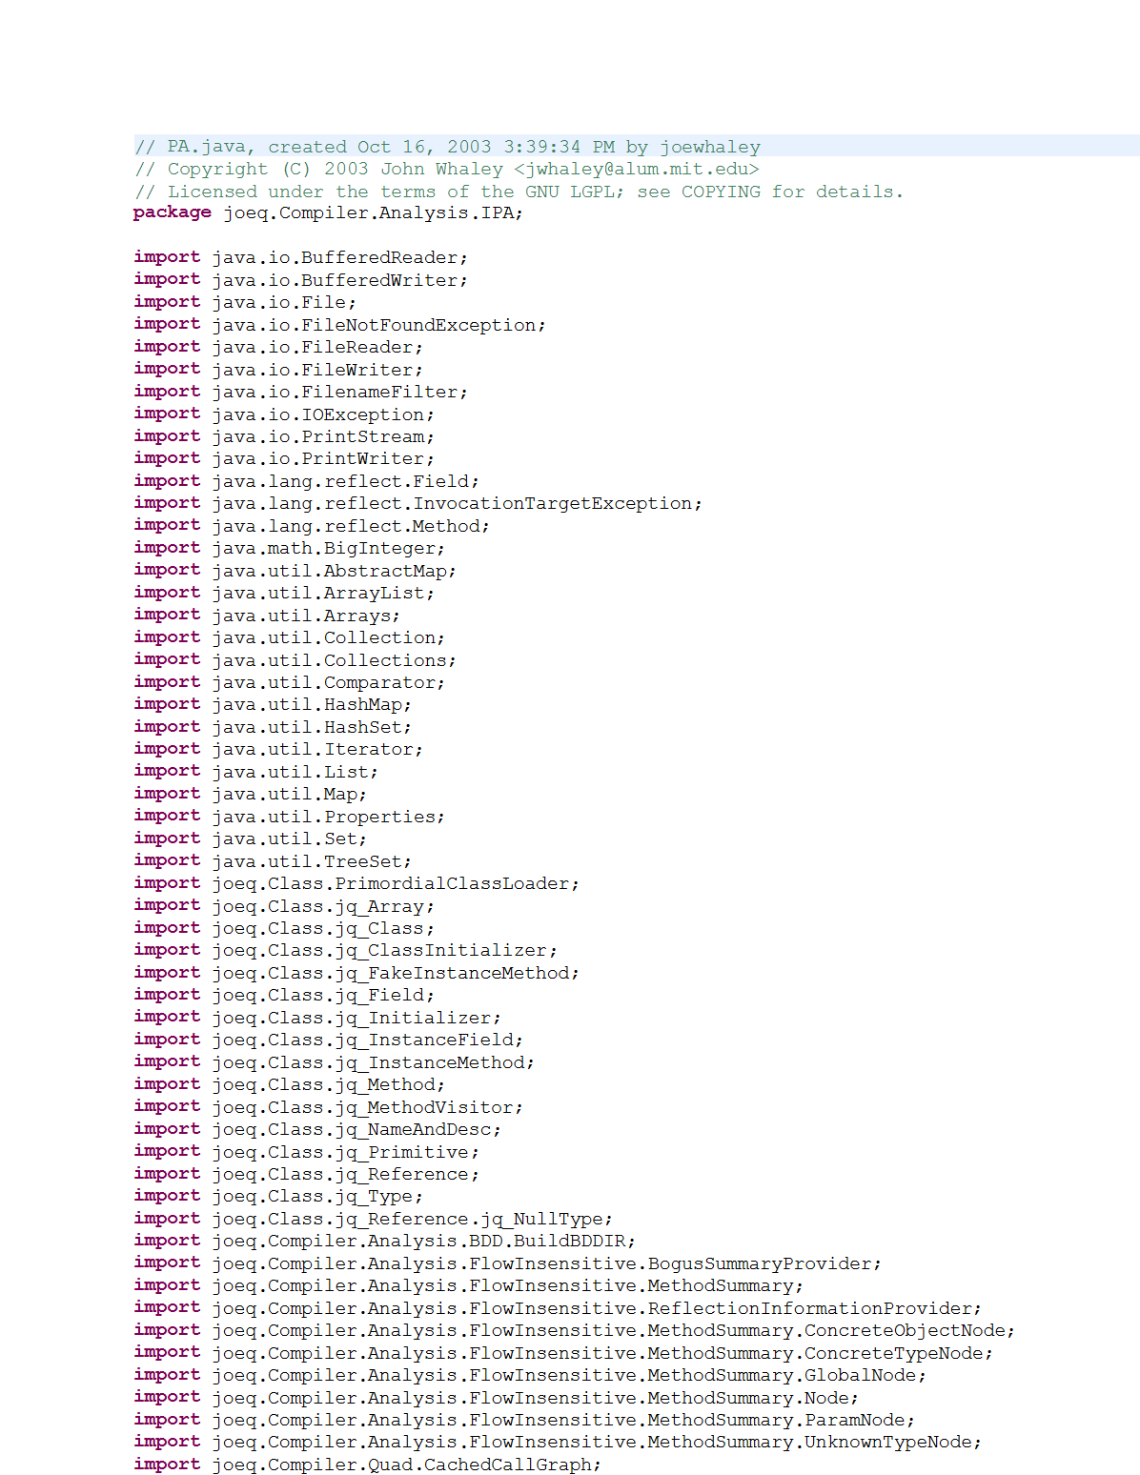
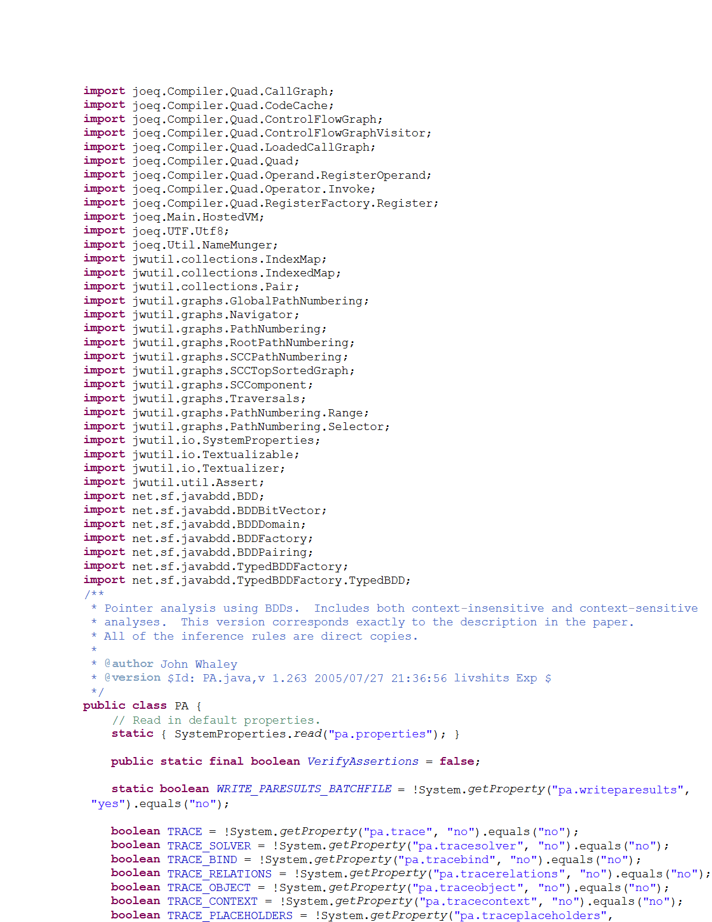


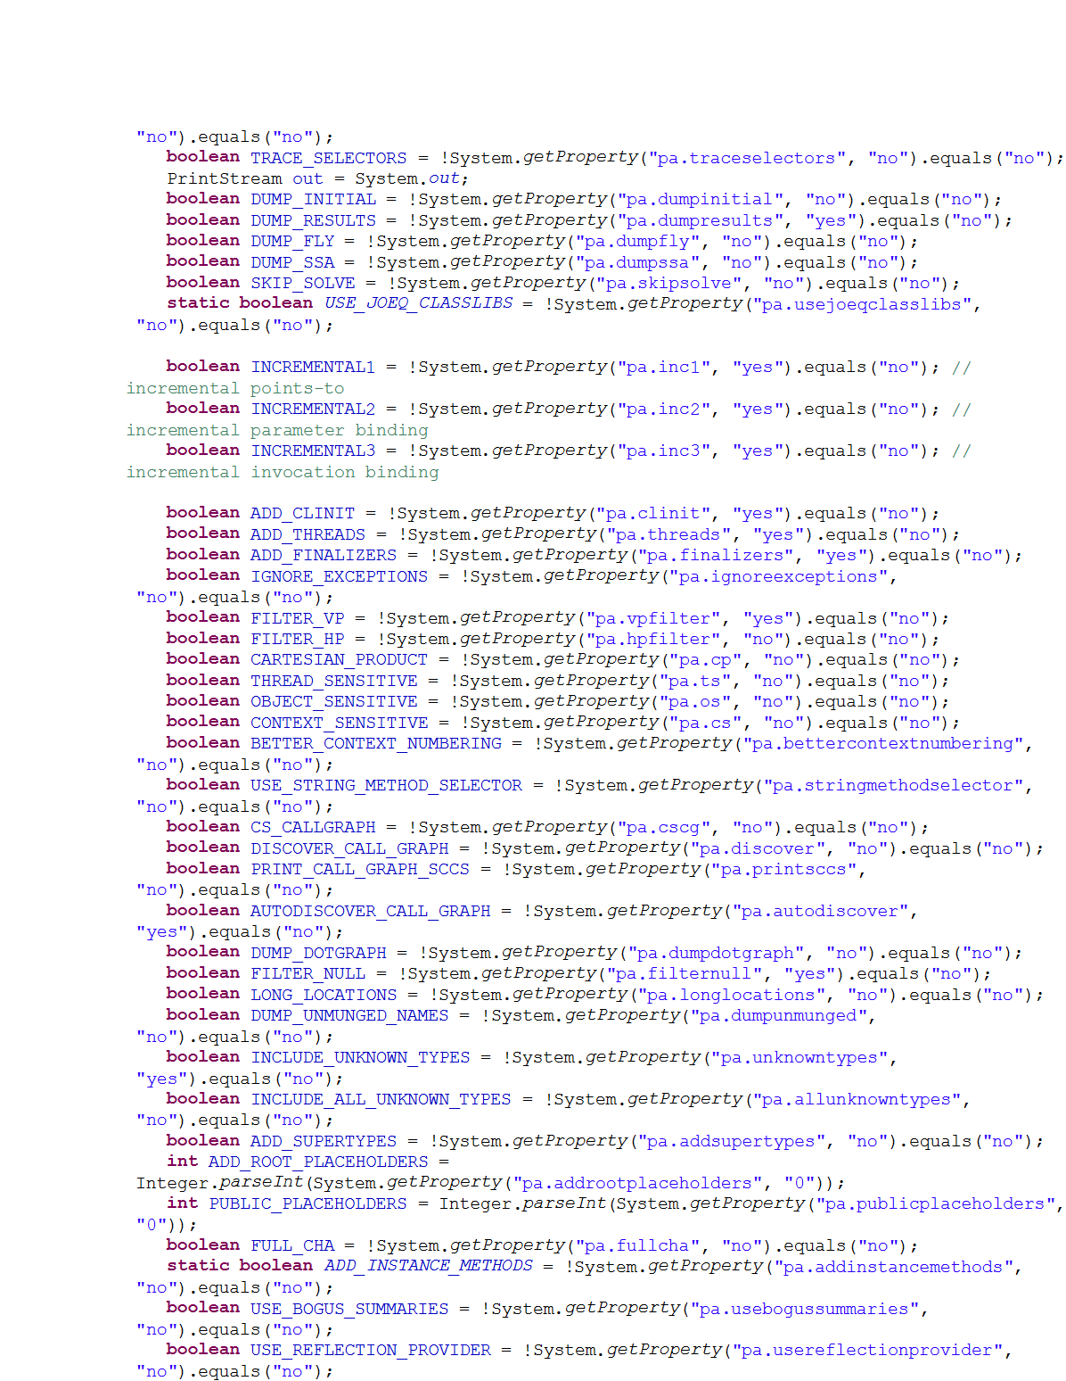
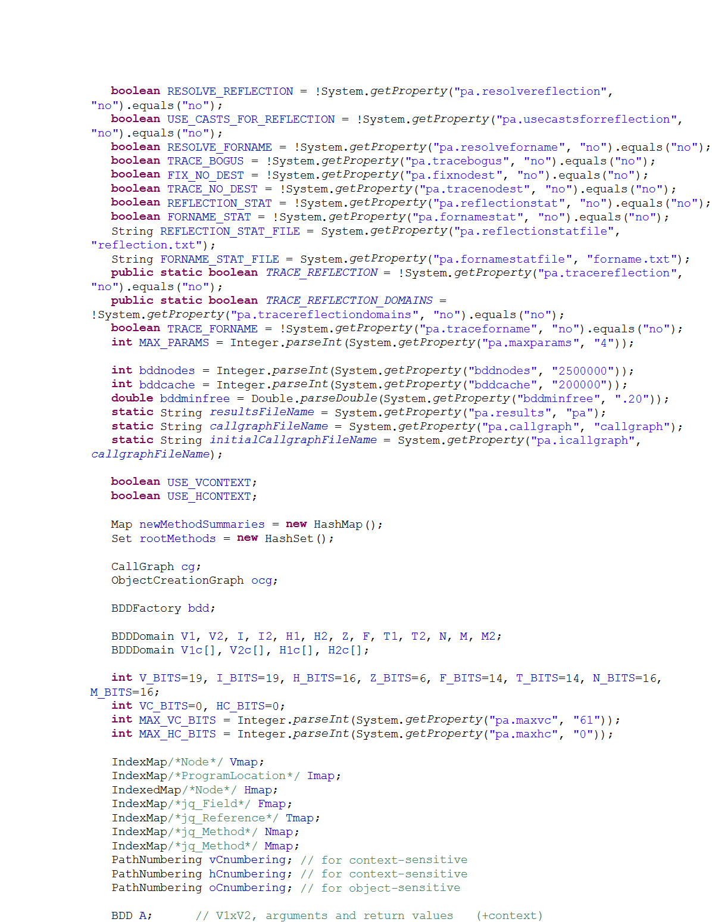
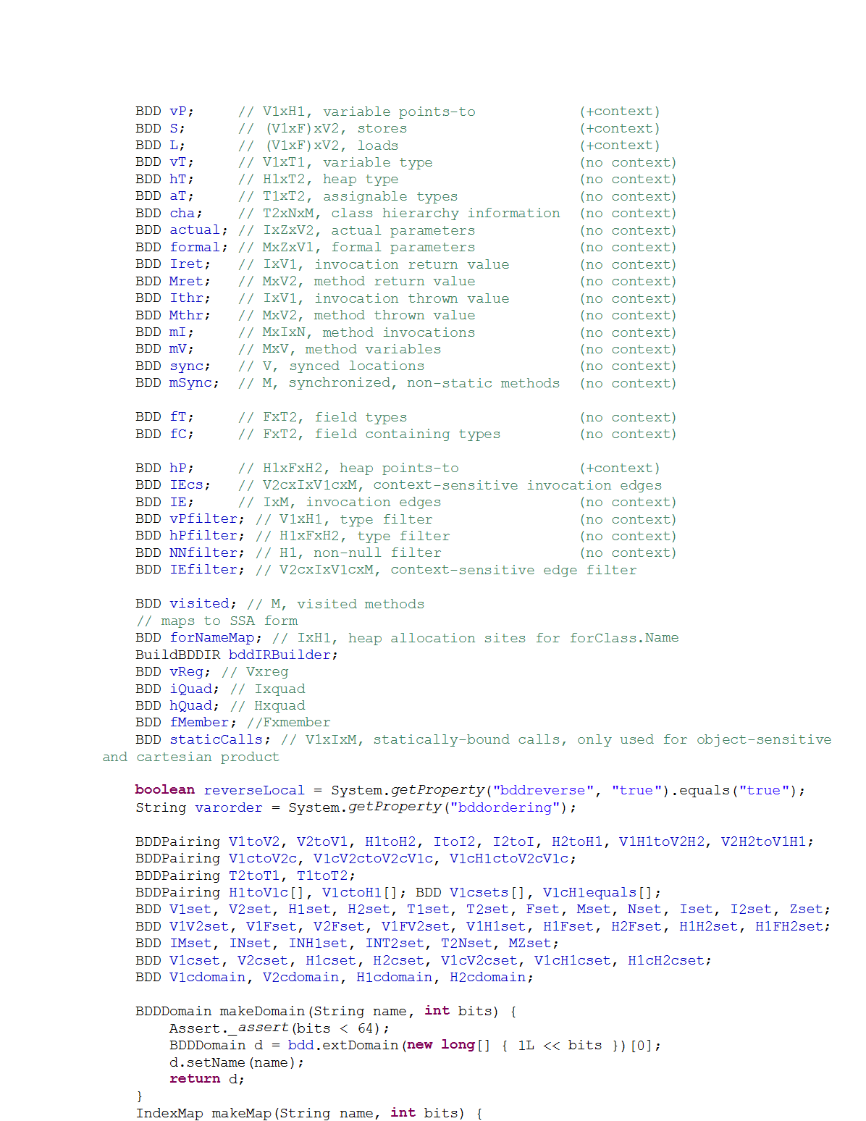
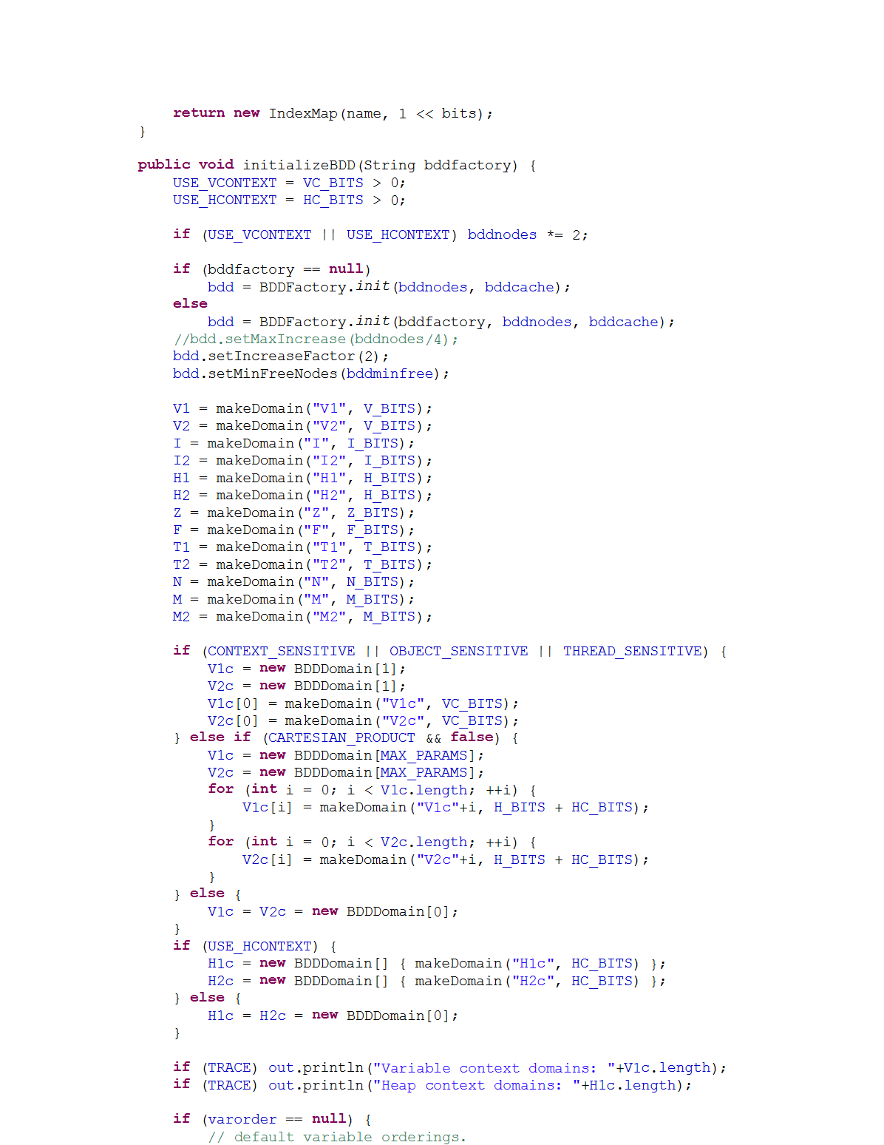
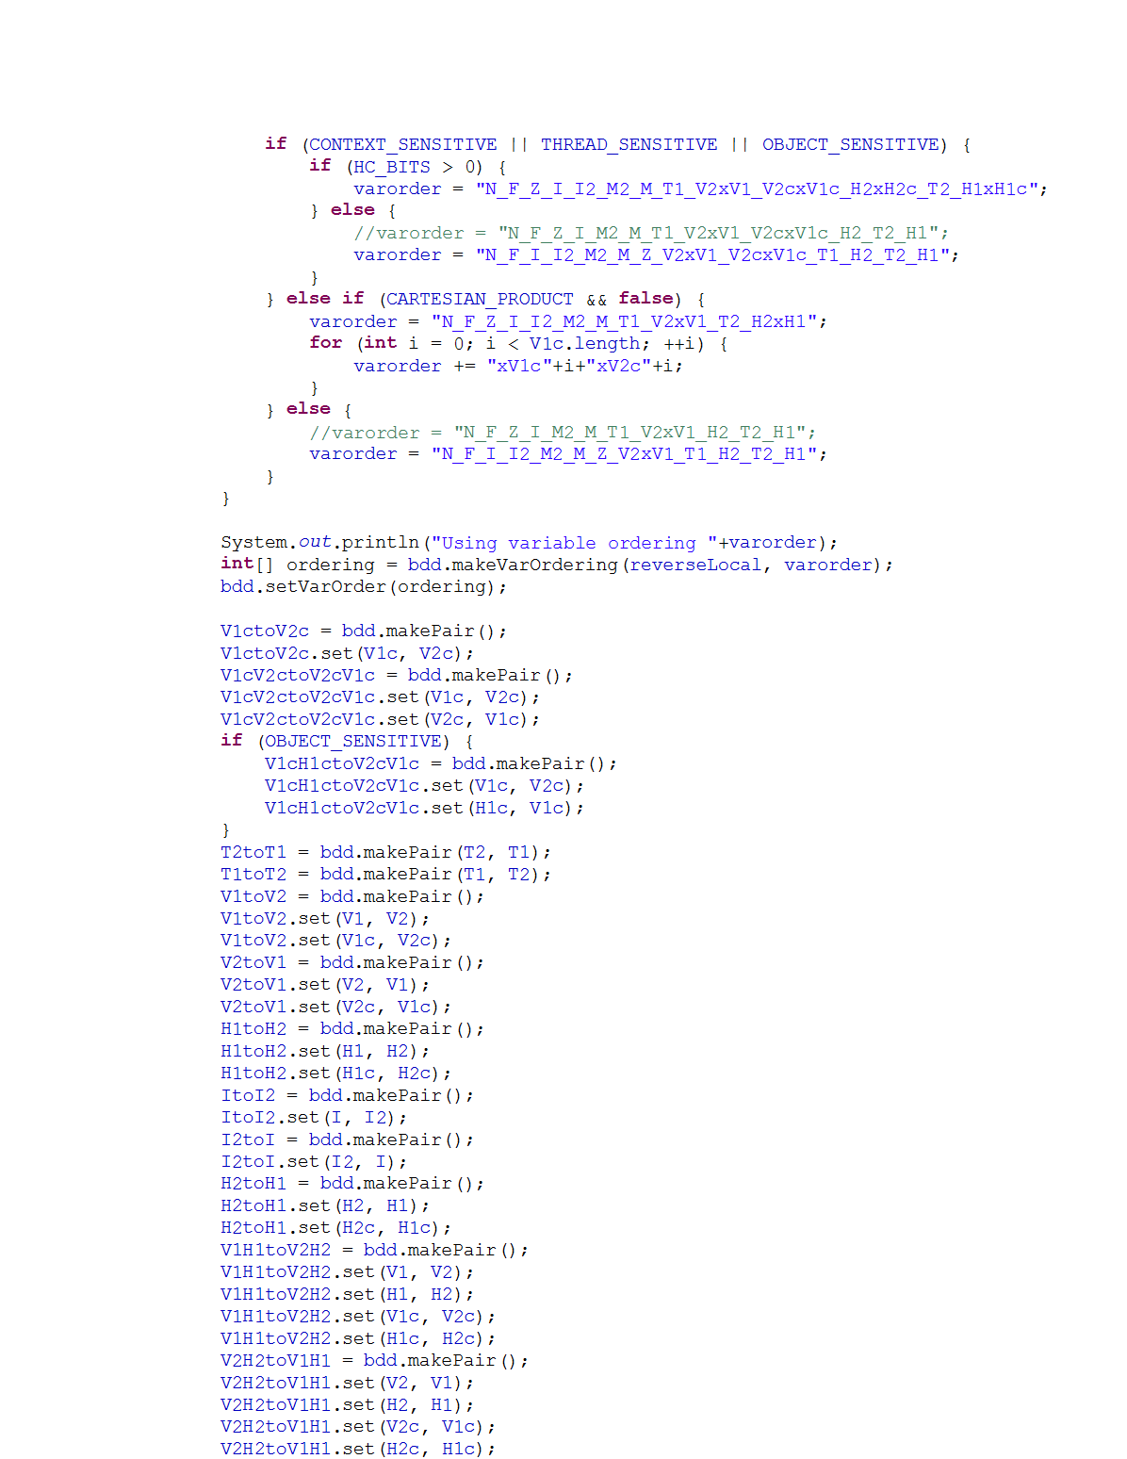
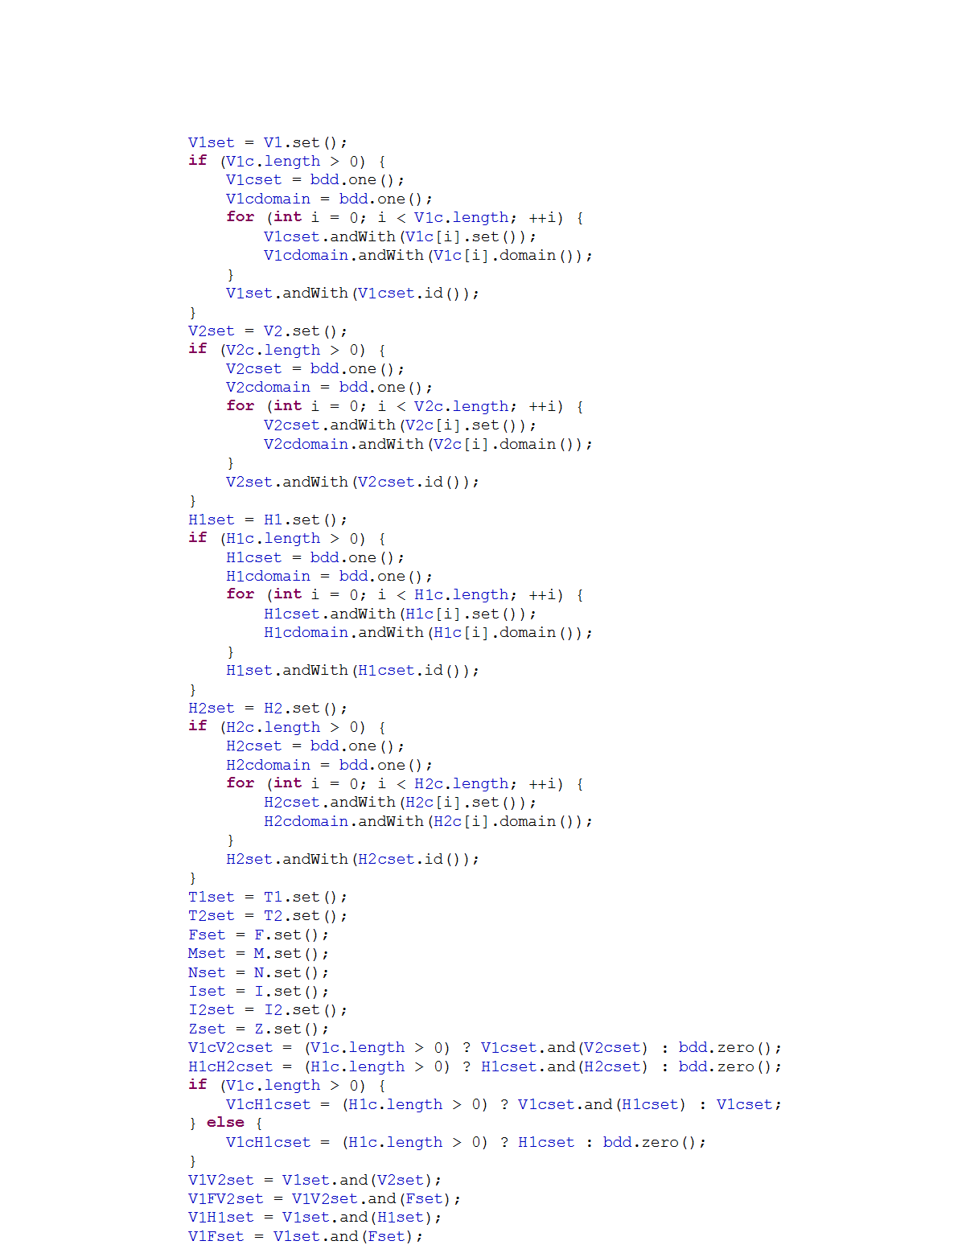
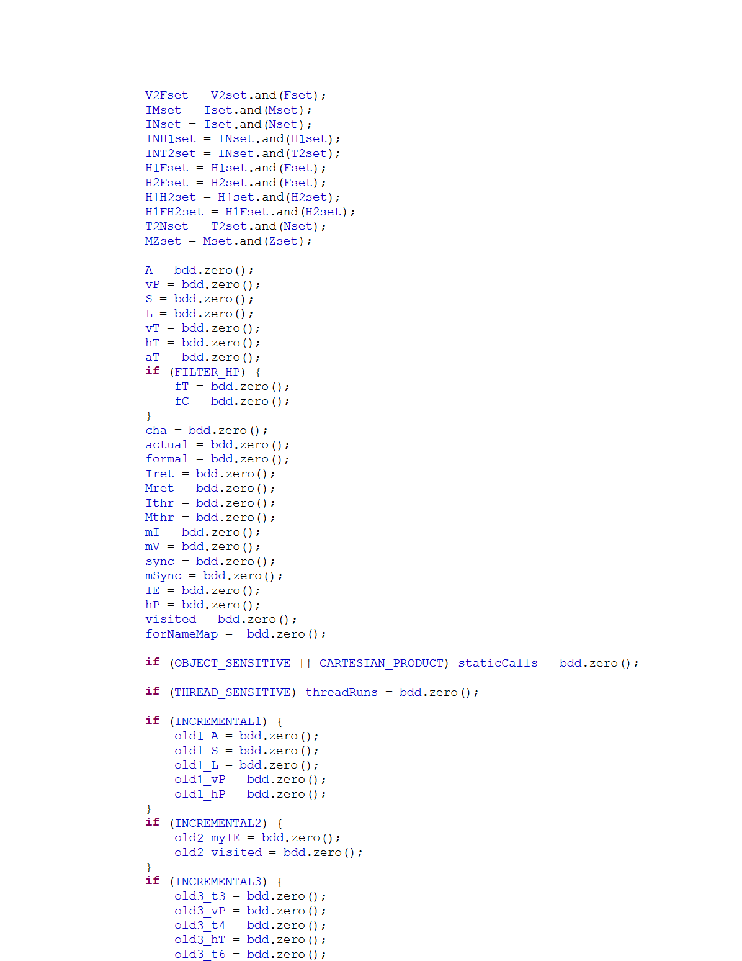
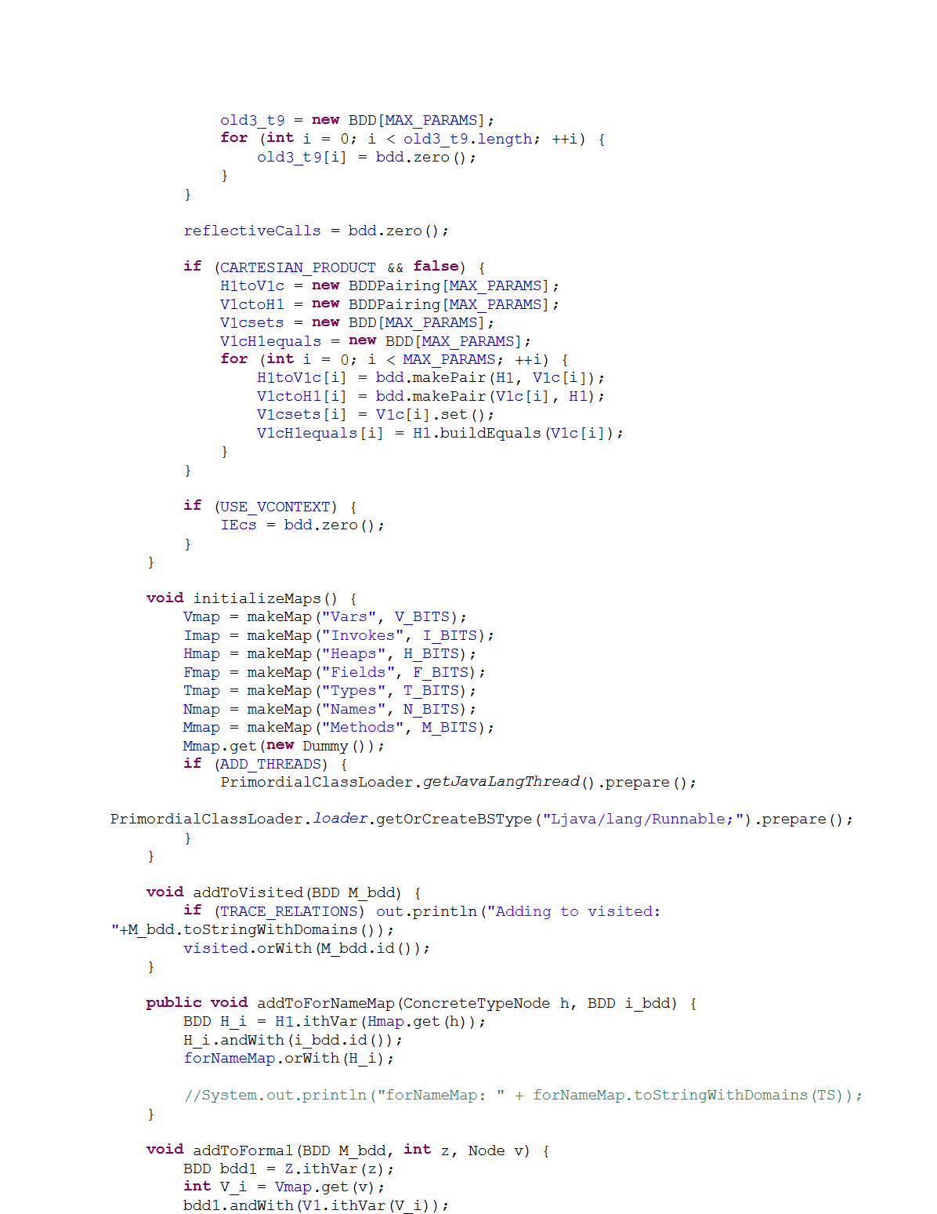
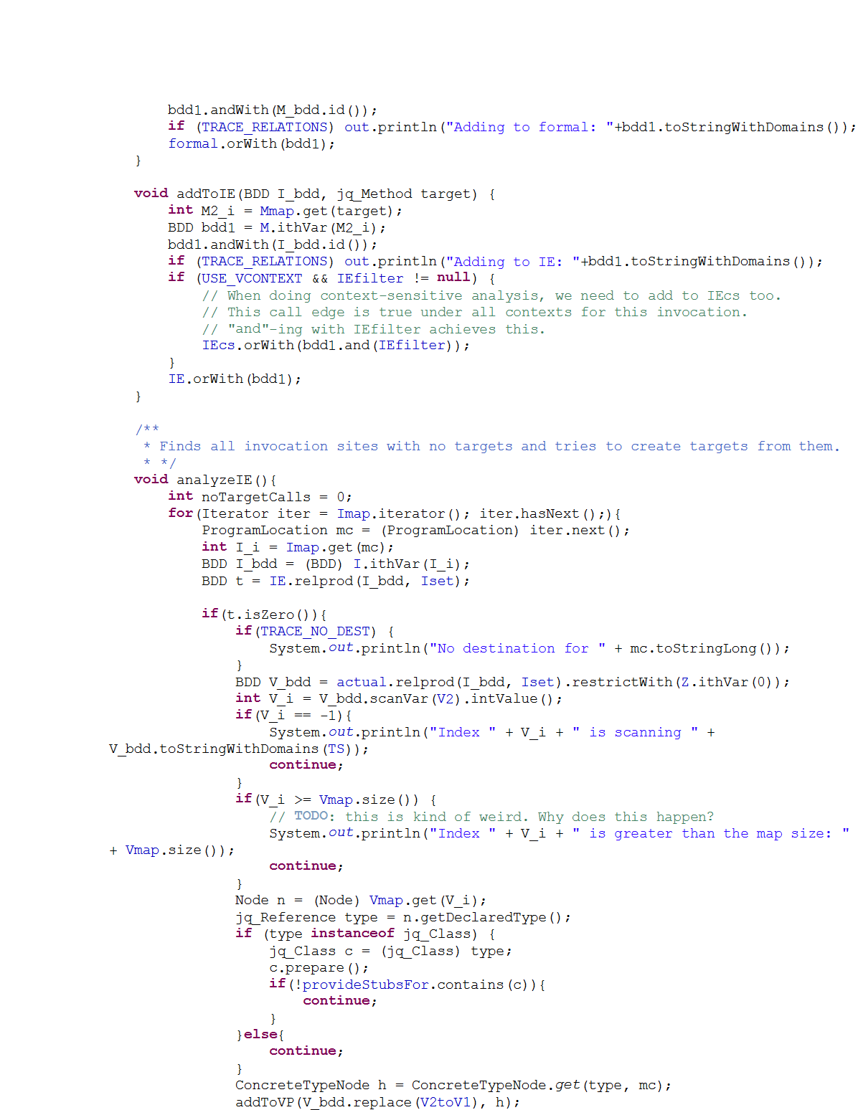
Motivation
Bug Reports
Program
Analysis
Analysis User
“People ignore the tool if more than
30% false positives are reported …”
[Coverity, CACM’10]

Slide 4
Our Key Idea
Shift decisions about usefulness of results
from analysis writers to analysis users
Approximations
Program
Analysis
Feedback
Analysis Writer
Analysis User

Slide 5
Example: Static Datarace Detection
Code snippet from Apache FTP Server
1 public class RequestHandler {
2 FtpRequestImpl request; 3 FtpWriter writer; 4 BufferedReader reader; 5 Socket controlSocket; 6 boolean isConnectionClosed; 7 … 8 public void getRequest( ) {
10 }
11 public void close( ) { 12 synchronized (this) { 13 if (isConnectionClosed)
14 return; 15 isConnectionClosed = true; 16 }
21 reader.close(); 22 reader = null; 23 controlSocket.close(); 24 controlSocket = null; 25 }
17 request.clear(); // x1
R2
18 request = null; // x2
R1
19 writer.close(); // y1
R3
20 writer = null; // y2
9 return request; // x0
R4
R5

Slide 6

Before User Feedback

Slide 7
After User Feedback

Slide 8
Our System For User-Guided Analysis

Slide 9
Logical Analysis

Slide 10
Logical Datarace Analysis Using Datalog
Input relations:
next(p1, p2), mayAlias(p1, p2), guarded(p1, p2)
Output relations:
parallel(p1, p2), race(p1, p2)
Rules:
parallel(p3, p2) :- parallel(p1, p2), next (p3, p1).
(2) parallel(p1, p2) :- parallel(p2, p1).
race(p1, p2) :- parallel(p1, p2), mayAlias(p1, p2), ¬guarded(p1, p2).
If p1 & p2 may happen in parallel,
and p3 is successor of p1,
then p3 & p2 may happen in parallel.
If p1 & p2 may happen in parallel,
and they may access the same memory location, and they are not guarded by the same lock,
then p1 & p2 may have a datarace.
p1 is immediate successor of p2.
p1 & p2 may access the same memory location.
p1 & p2 are guarded by the same lock.
If p2 & p1 may happen in parallel,
then p1 & p2 may happen in parallel.
p1 & p2 may happen in parallel.
p1 & p2 may
have a datarace.

Slide 11
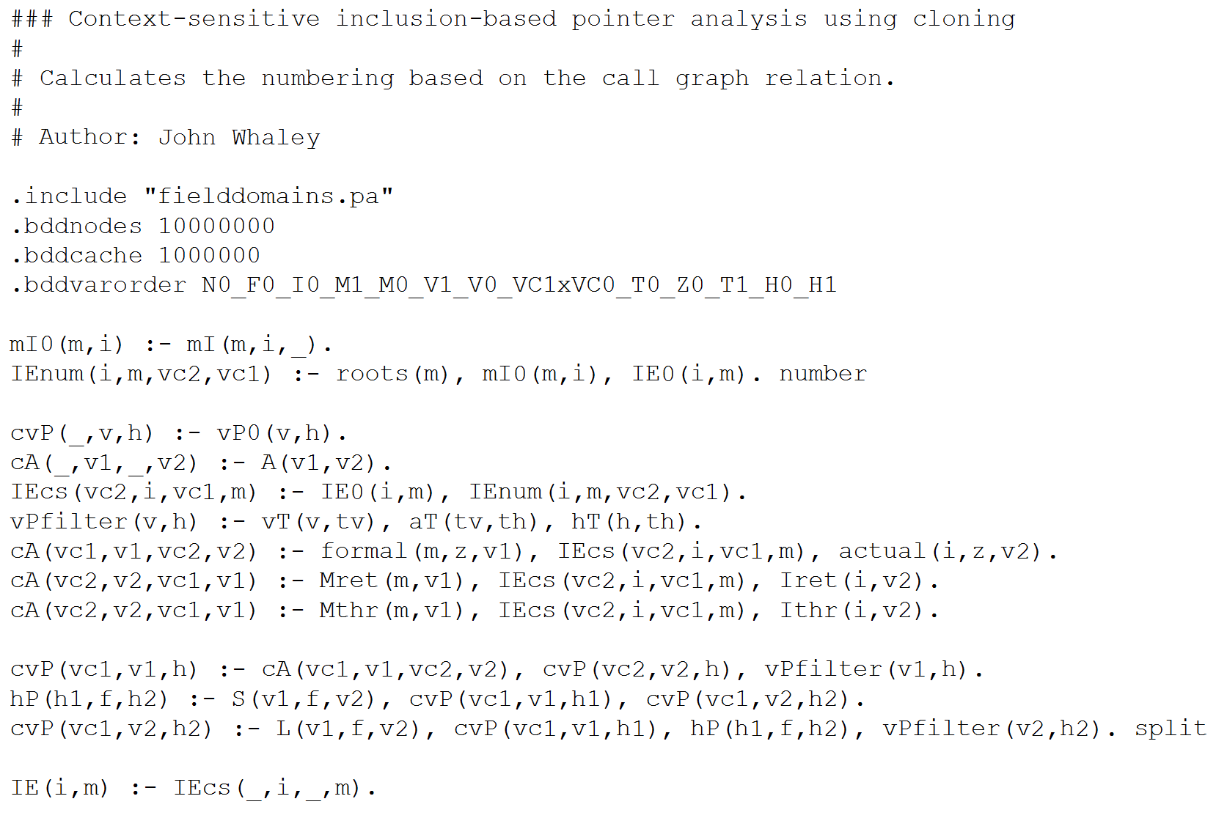
Why Datalog?
Easier to specify
Analysis in Java
Analysis in Datalog
vs.

Slide 12








Why Datalog?
Easier to specify
Leverage efficient solvers
Widely adaptable

Slide 13
Probabilistic Analysis

Slide 14
Datarace Analysis: Logical ➔ Probabilistic
Input relations:
next(p1, p2), mayAlias(p1, p2), guarded(p1, p2)
Output relations:
parallel(p1, p2), race(p1, p2)
Rules:
parallel(p3, p2) :- parallel(p1, p2), next (p3, p1).
(2) parallel(p1, p2) :- parallel(p2, p1).
race(p1, p2) :- parallel(p1, p2), mayAlias(p1, p2), ¬guarded(p1, p2).
¬race(x2, x1).
“Soft” Rule
“Hard” Rule
weight 5
weight 25

Slide 15
A Semantics for Probabilistic Analysis
Probabilistic Analysis => Markov Logic Network (MLN)
[Richardson & Domingos, Machine Learning’06 ]
MLN defines a probability distribution over all possible analysis outputs
Probability of an output x:
Normalization
factor
Weight of
rule i
Number of true instances of rule i in x

Slide 16
Inference Engine

Slide 17
Probabilistic Inference
Find the most likely output given the input program

Slide 18
What is MaxSAT?
¬ b1 ∨ ¬ b2 ∨ b3 weight 5 ∧
b3 ∨ b4 weight 10 ∧
¬ b4 ∨ ¬ b2 weight 7 ∧
...
Find a boolean assignment such that the sum of
the weights of the satisfied clauses is maximized

Slide 19
Probabilistic Inference ➔ MaxSAT
Find the most likely output given the input program
Solve the MaxSAT instance entailed by the MLN

Slide 20
Example: Static Datarace Detection
Code snippet from Apache FTP Server
1 public class RequestHandler {
2 FtpRequestImpl request; 3 FtpWriter writer; 4 BufferedReader reader; 5 Socket controlSocket; 6 boolean isConnectionClosed; 7 … 8 public void getRequest( ) {
10 }
11 public void close( ) { 12 synchronized (this) { 13 if (isConnectionClosed)
14 return; 15 isConnectionClosed = true; 16 }
21 reader.close(); 22 reader = null; 23 controlSocket.close(); 24 controlSocket = null; 25 }
17 request.clear(); // x1
R2
18 request = null; // x2
R1
19 writer.close(); // y1
R3
20 writer = null; // y2
9 return request; // x0
R4
R5

Slide 21
How Does Online Phase Work?
Input facts: next(x2, x1), mayAlias(x2, x1), ¬guarded(x2, x1), next(y1, x2), mayAlias(y2, y1), ¬guarded(y2, y1)
MaxSAT formula: (parallel(x1, x1) ∧ next(x2, x1) => parallel(x2, x1)) weight 5 ∧
(parallel(x1, x2) ∧ next(x2, x1) => parallel(x2, x2)) weight 5 ∧
􏰂 (parallel(x2, x2) ∧ next(y1, x2) => parallel(y1, x2)) weight 5 ∧ (parallel(y2, y1) ∧ mayAlias(y2, y1) ∧ ¬guarded(y2, y1) => race(y2, y1)) ∧
(parallel(x2, x1) ∧ mayAlias(x2, x1) ∧ ¬guarded(x2, x1) => race(x2, x1)) ∧
¬race(x2, x1) weight 25
Output facts (before feedback): parallel(x2, x0), race(x2, x0), parallel(x2, x1), race(x2, x1), parallel(y2, y1), race(y2, y1)
Output facts (after feedback):
parallel(x2, x0), race(x2, x0)

Slide 22
Learning Engine

Slide 23
Weight Learning
Learn rule weights such that the probability
of the training data is maximized
Perform gradient descent
[Singla & Domingos, AAAI’05]

Slide 24
Putting It All Together

Slide 25
Empirical Evaluation Questions
RQ1: Does user feedback help in improving analysis precision?
RQ2: How much feedback is needed and does the amount of feedback affect the precision?
RQ3: How feasible is it for users to inspect analysis output and provide useful feedback?

Slide 26
Empirical Evaluation Setup
Control Study:
Analyses: (1) Pointer analysis, (2) Datarace analysis
Benchmarks: 7 Java programs (130-200 KLOC each)
Feedback: Automated [Zhang et.al, PLDI’14]
User Study:
Analyses: Information flow analysis
Benchmarks: 3 security micro-benchmarks
Feedback: 9 users

Slide 27
Benchmarks Characteristics
 | classes | methods | bytecode(KB) | KLOC
antlr | 350 | 2.3K | 186 | 131
avrora | 1,544 | 6.2K | 325 | 193
ftp | 414 | 2.2K | 118 | 130
hedc | 353 | 2.1K | 140 | 153
luindex | 619 | 3.7K | 235 | 190
lusearch | 640 | 3.9K | 250 | 198
weblech | 576 | 3.3K | 208 | 194
secbench1 | 5 | 13 | 0.3 | 0.6
secbench2 | 4 | 12 | 0.2 | 0.6
secbench3 | 17 | 46 | 1.3 | 4.2
Control
Study
User
Study

Slide 28
Precision Results: Pointer Analysis
10%
5%
20%
15%

Slide 29
Precision Results: Datarace Analysis
RQ1, RQ2: With only up to 20% feedback, 70% of the false positives are eliminated and 98% of true positives retained.

Slide 30
Precision Results: User Study
User 6
…
User 2
User 1
RQ3: Users only need 8 minutes on average to provide
useful feedback that improves analysis precision
showing feasibility of approach.

Slide 31
Conclusion
Approximations are a necessary evil in program analysis
Our contributions:
Paradigm: Incorporate user feedback to guide approximations
Method: Datalog ➔ MLN ➔ MaxSAT
Results: Eliminates most false positives (~70%) at the cost of introducing few false negatives (~2%) with limited feedback
Systematically combining program analysis and machine learning techniques with human intelligence is the future

